Slide 1
Detecting Phishing Websites Using Machine Learning
Capstone Project – Power BI & Python
Akariza GASANA Leslie (27413)
Adventist University of central Africa

Slide 2
Project Introduction
Problem Statement: "Can machine learning effectively differentiate between phishing and legitimate websites?" Background: Phishing is a type of cyberattack in which attackers impersonate trustworthy entities to steal sensitive information. Traditional methods to detect phishing websites rely on blacklists or manual reporting, which are often slow and reactive. Using machine learning, we aim to proactively detect phishing websites based on their structural and statistical attributes.
Dataset: Phishing Websites - UCI Machine Learning
Power bi project: Bigdata final project.pbix
Repository: Leslie-24/Final

Slide 3
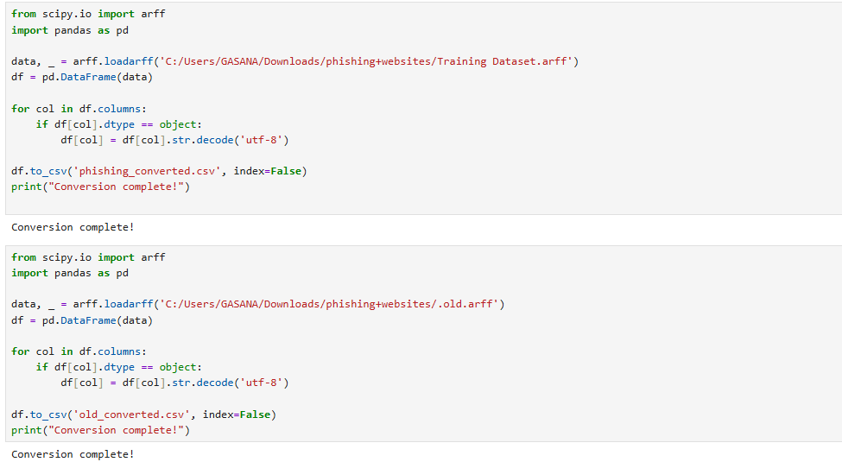
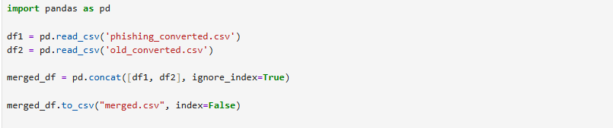
Methodology
Dataset: - Sourced from an open dataset of phishing and legitimate URLs
Phishing Websites - UCI Machine Learning Repository The steps went through for the to be ready are :
-Conversion from .arff to .csv
-Merging the datasets

Slide 4
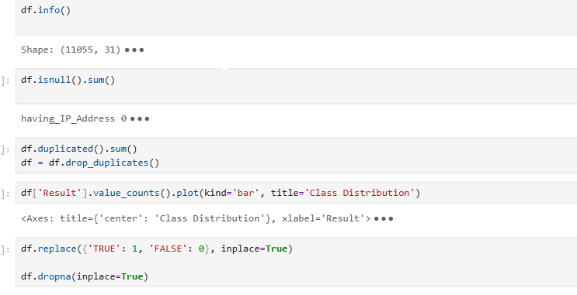
Data Cleaning
- Cleaned missing values and encoded categorical fields

Slide 5
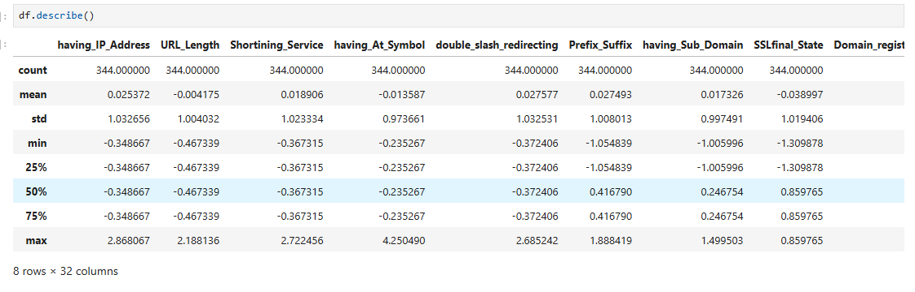
EDA

Slide 6
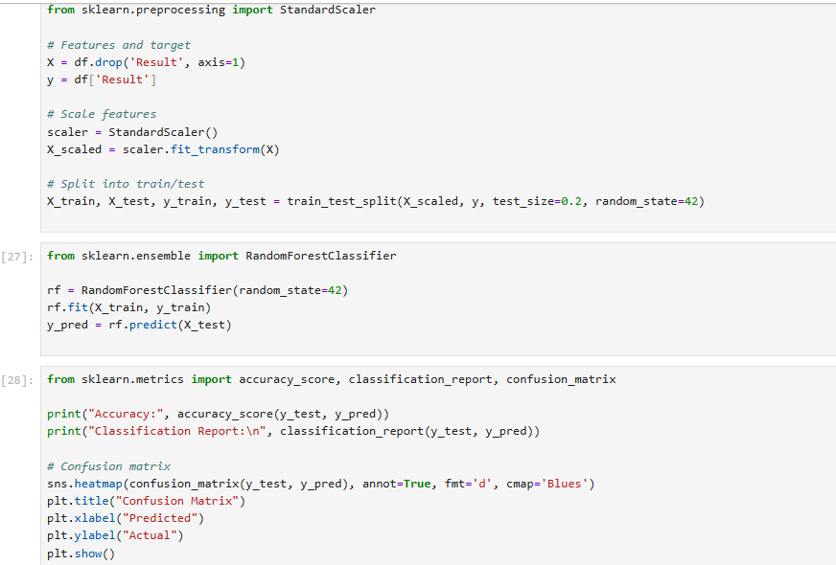
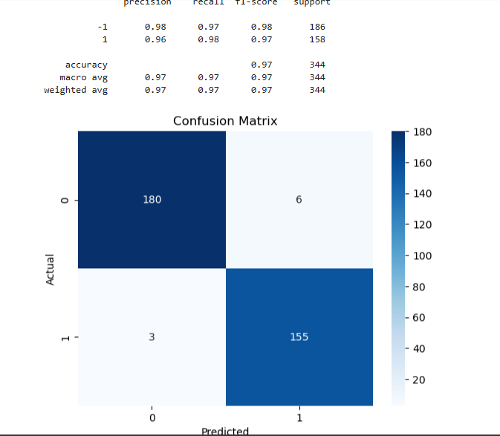
Modeling - Classification model trained on the processed dataset - Evaluated using accuracy, confusion matrix, precision and recall

Slide 7
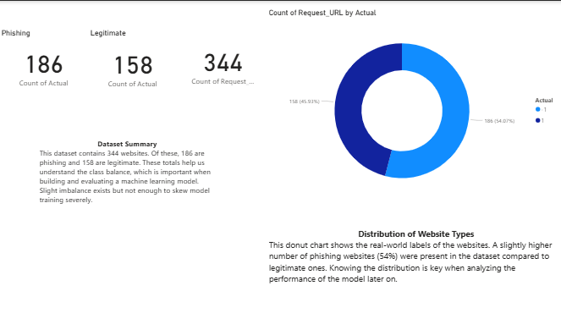
Dataset Summary
Insights: - Helps understand class balance in the dataset - Imbalanced classes may require sampling techniques (SMOTE, undersampling) Total URLs, # of phishing, # of legitimate

Slide 8
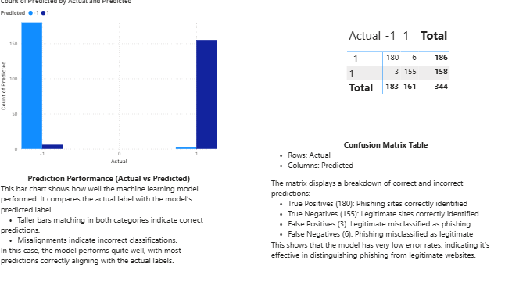
Model Performance
Interpretation: - High true positive and true negative rates suggest reliable predictions - Low false positives reduce the risk of legitimate sites being flagged - Confirms that ML can effectively distinguish phishing websites

Slide 9
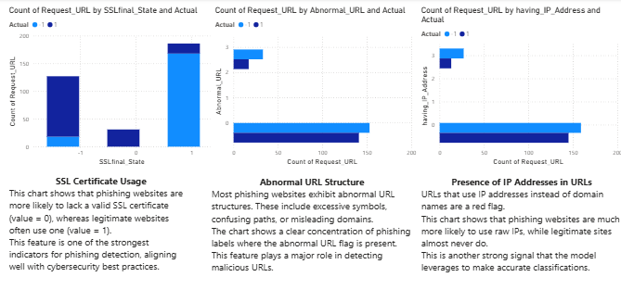
Key Feature Insights
Findings: - Phishing websites are far more likely to have abnormal URLs and missing SSL certificates - Presence of IP addresses in URLs is also a strong indicator of phishing behavior

Slide 10
Recommendations
- Integrate the model into security tools like email filters and browsers - Conduct user education on suspicious URL patterns (e.g., '@', IP address, pop-ups) - Continuously update training data with newly reported phishing websites - Combine with real-time domain reputation APIs for enhanced protection

Slide 11
Future Work
- Expand dataset to include thousands of labeled URLs from global sources - Incorporate content-based features using NLP (e.g., webpage text analysis) - Explore advanced models: Random Forest, Gradient Boosting, Deep Learning - Build a live Power BI dashboard for phishing threat monitoring and alerts

